Slide 1

Proposition du PFE
Solving Model heterogeneity
and catastrophic forgetting

Slide 2
Sommaire
What is catastrophic forgetting ? (show forgetting in 1 neurone)
Proposed solutions /review → Examplar models
(propose diffusion/generative A.I on Crosscorrelation + Fisher information matrix (FIM) )
Introduce continual Learning paradigms [scenarios and Experience] which best fit Federated Learning
[Domain-incremental (new classes and new instances)]
Introduce Avelanche for continual learning . Example of scenario and benchmark Collab
Introduce Fedsam https://github.com/debcaldarola/fedsam +Wandb logging
Proposal (svg)
Future works I: incorporate Liquid Neural nets and try metaODEs as distilled models to send back to clients (Extrapolation + size)
https://github.com/mlech26l/ncps https://ncps.readthedocs.io/en/latest/examples/torch_first_steps.html
https://ncps.readthedocs.io/en/latest/quickstart.html
Future works II: incoporate BRU activation functions
Future works III: Self-Net: Lifelong Learning via Continual Self-Modeling

Slide 3
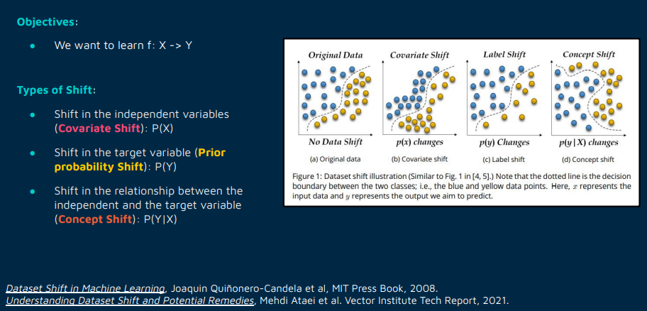
What is catastrophic forgetting ? (show forgetting in 1 neurone and permuted MNIST example)
https://colab.research.google.com/github/ContinualAI/colab/blob/master/notebooks/forgetting_with_one_neuron.ipynb
https://colab.research.google.com/github/ContinualAI/colab/blob/master/notebooks/permuted_and_split_mnist.ipynb
  Source: https://course.continualai.org/lectures/scenarios-and-benchamarks page 5

Slide 4
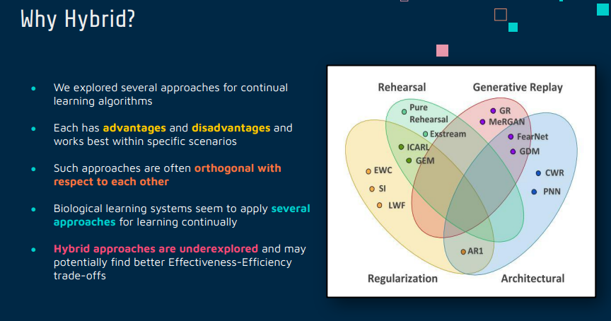
Source : https://course.continualai.org/lectures/strategies page 4
Proposed solutions /review

Slide 5
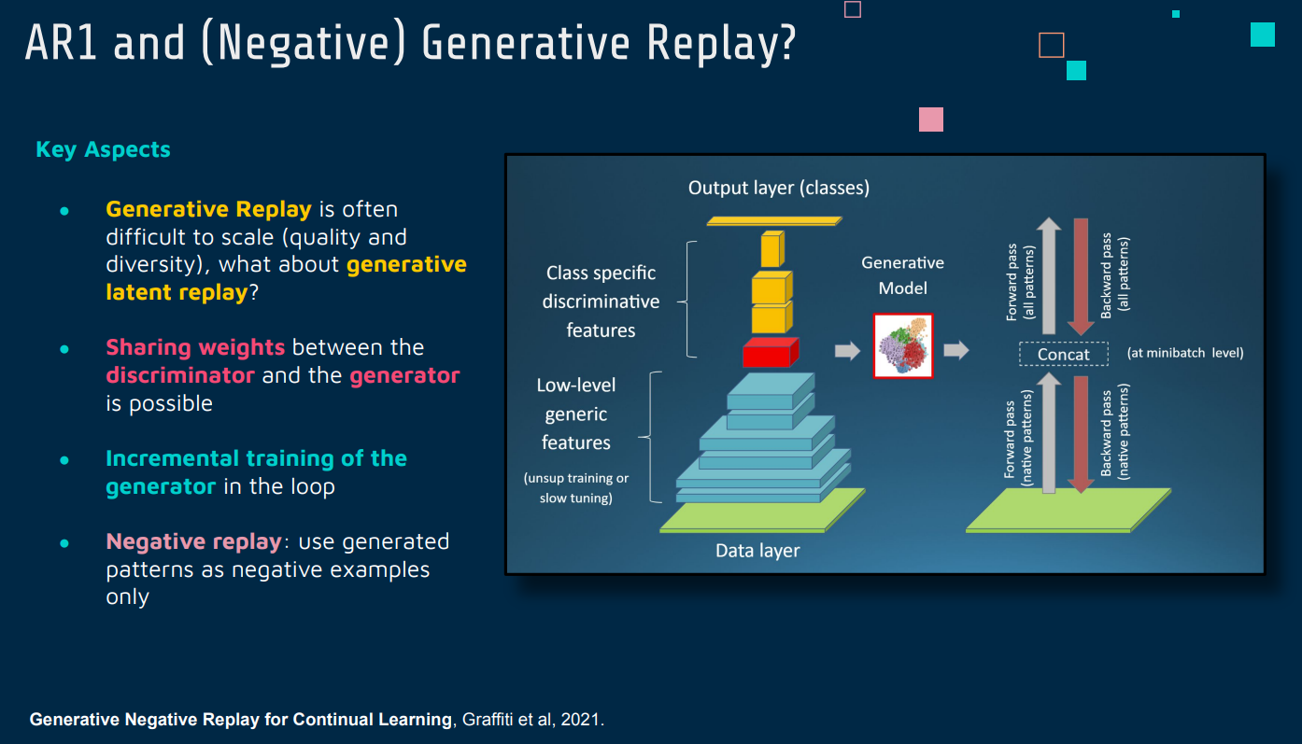
Examplar models (propose diffusion/generative A.I on Crosscorrelation + Fisher information matrix (FIM) )
Source : https://course.continualai.org/lectures/strategies page 15

Slide 6
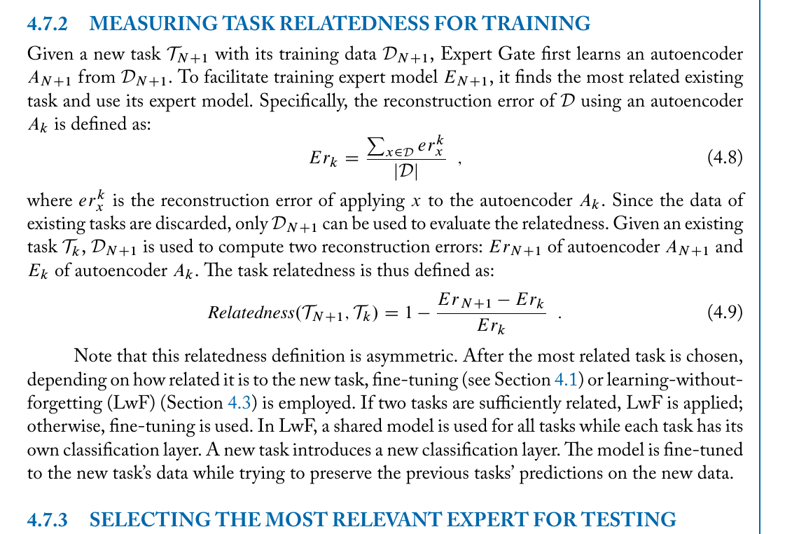
Source : „Learning without forgetting“ (view attached zip)

Slide 7
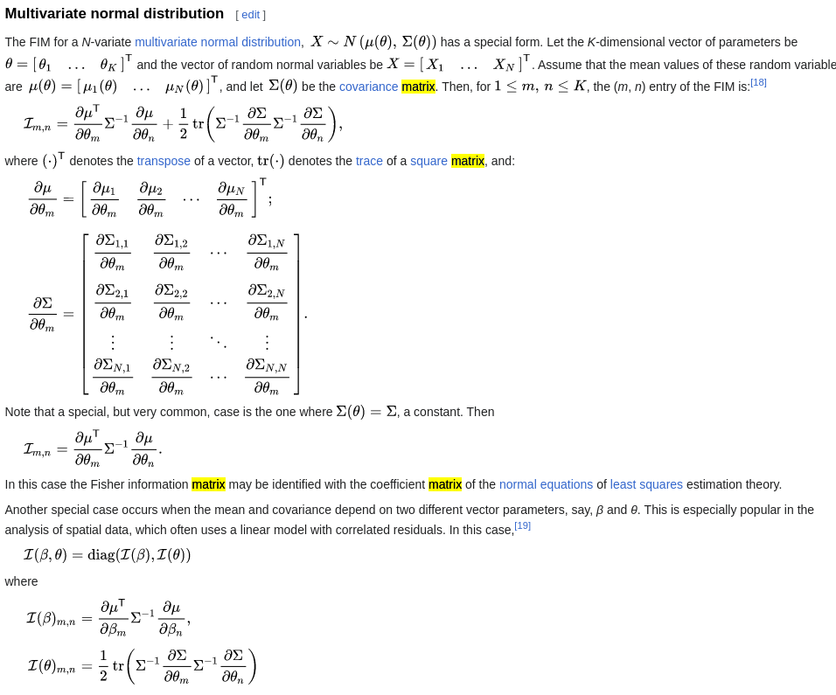
Source : https://en.wikipedia.org/wiki/Fisher_information#Matrix_form

Slide 8
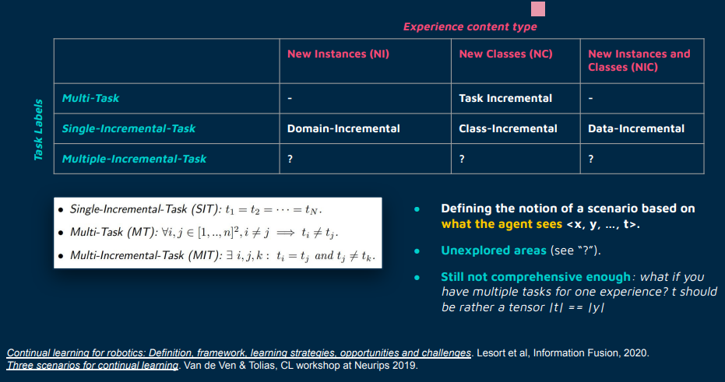
Introduce continual Learning paradigms
[scenarios and Experience] which best fit Federated Learning
[Domain-incremental (new classes and new instances)]
Source : https://course.continualai.org/lectures/scenarios-and-benchamarks page 10

Slide 9
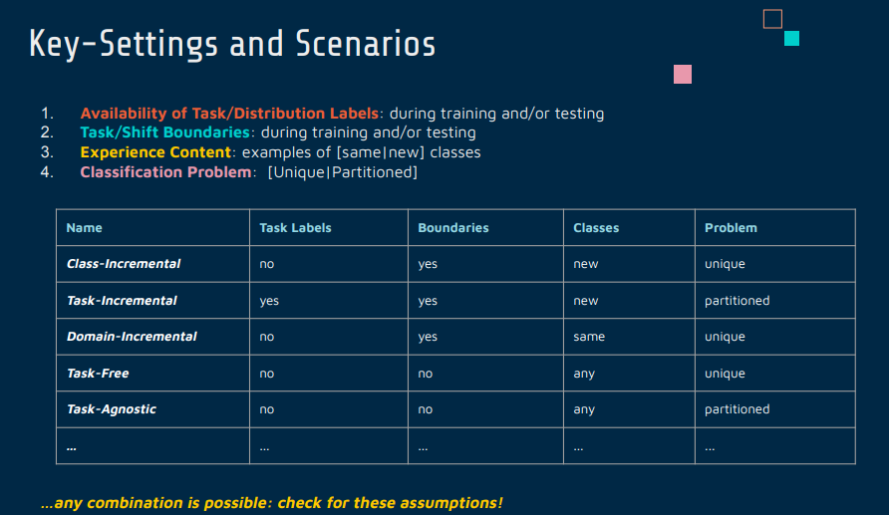
Introduce Avelanche for continual learning . Example of scenario and benchmark Collab
https://course.continualai.org/lectures/scenarios-and-benchamarks page 9

Slide 10
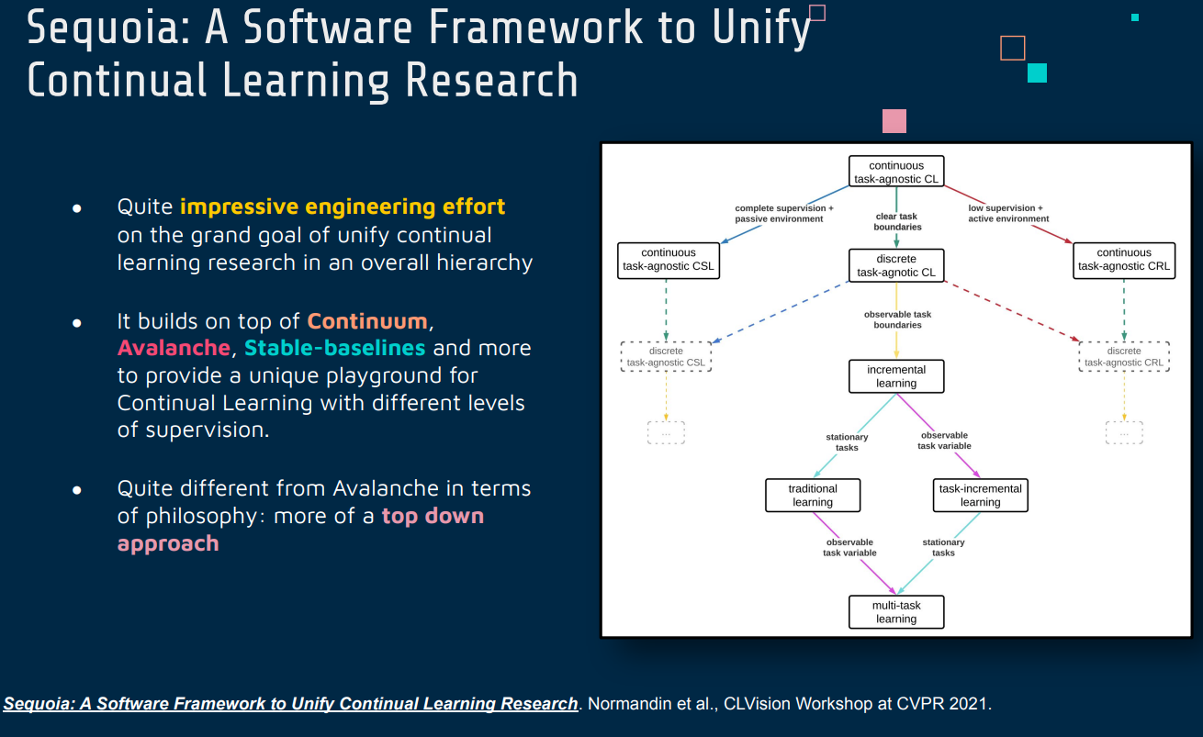
Source : https://course.continualai.org/lectures/methodologies-part-3-applications-and-tools page 25

Slide 11
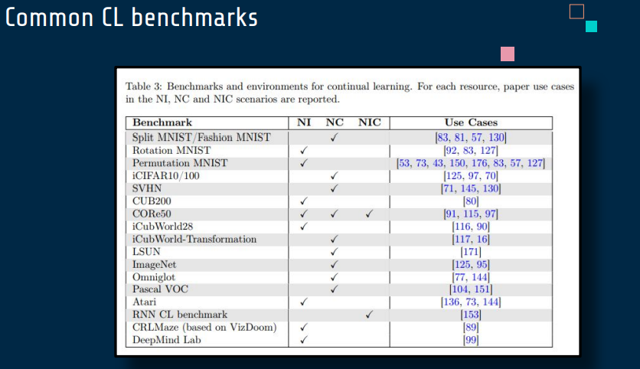
Source : https://course.continualai.org/lectures/scenarios-and-benchamarks page 13

Slide 12
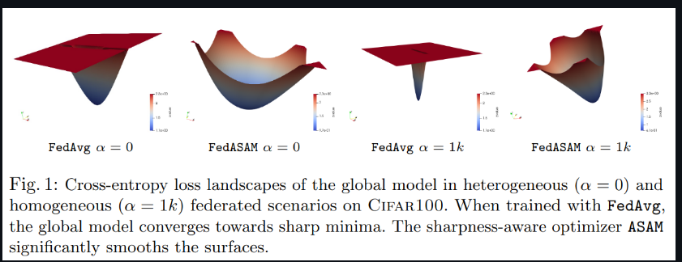
Introduce Fedsam https://github.com/debcaldarola/fedsam +Wandb logging
https://github.com/debcaldarola/fedsam

Slide 13
Proposal (svg) (attached)

Slide 14
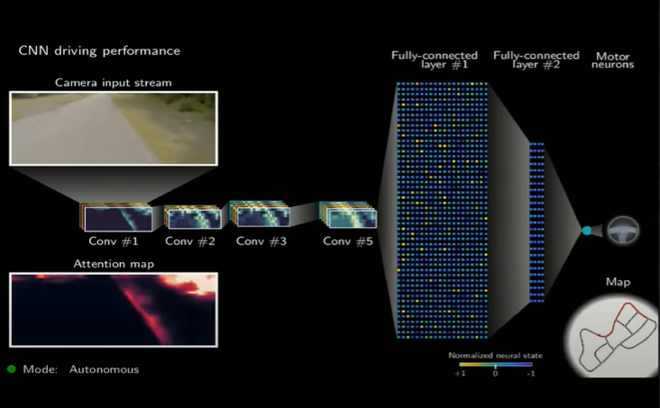
Liquid Time Constant neural networks
https://www.youtube.com/watch?v=IlliqYiRhMU&t=922s (timestamp 7:19)

Slide 15
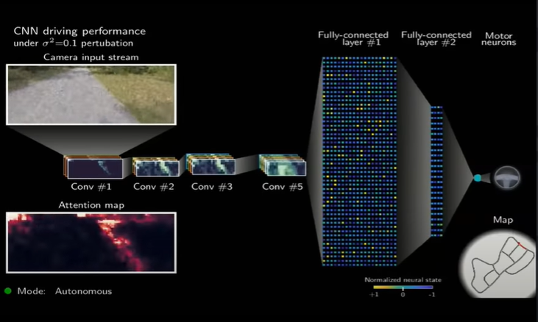
https://youtu.be/IlliqYiRhMU?t=461
https://youtu.be/IlliqYiRhMU?t=461

Slide 16
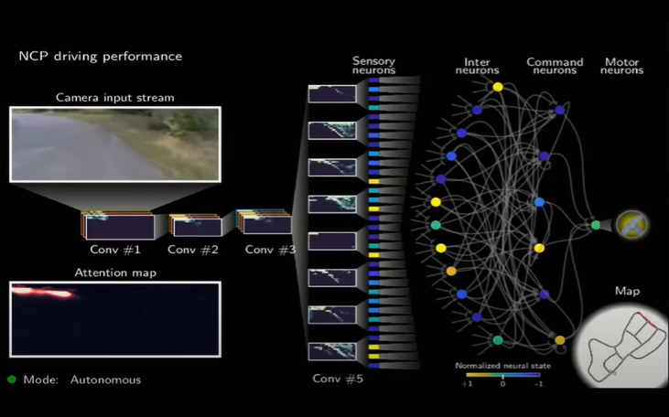
https://youtu.be/IlliqYiRhMU?t=1996

Slide 17
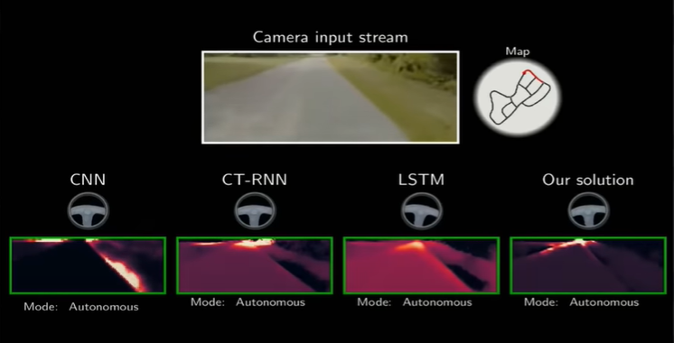
https://youtu.be/IlliqYiRhMU?t=2034

Slide 18
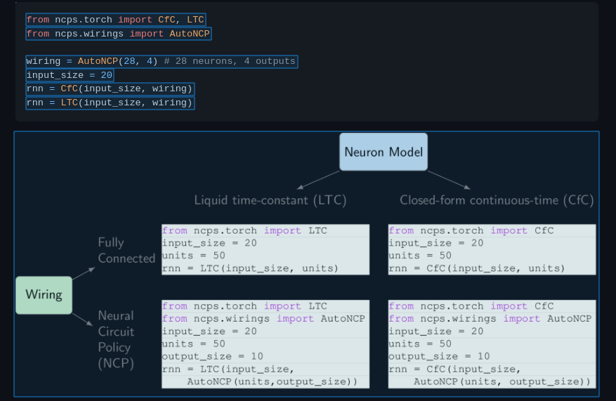
https://github.com/mlech26l/ncps

Slide 19
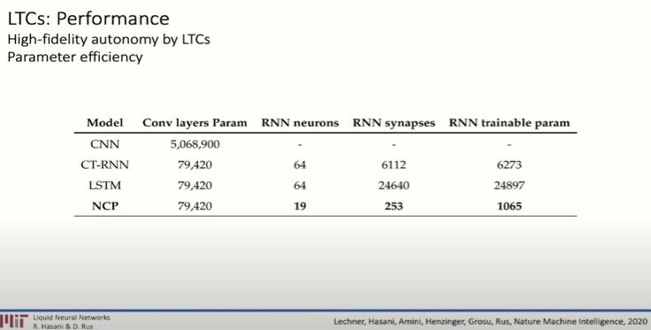
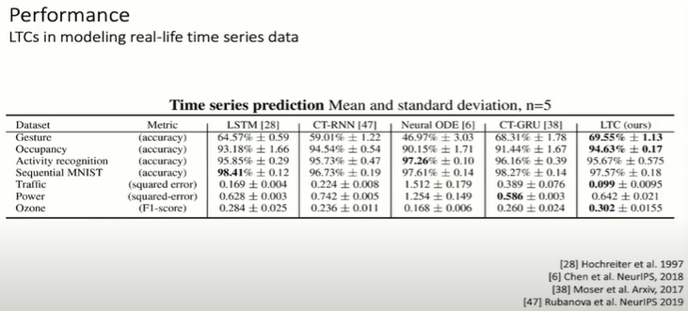

Slide 20
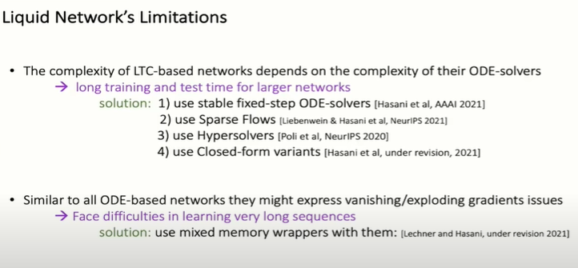

Slide 21
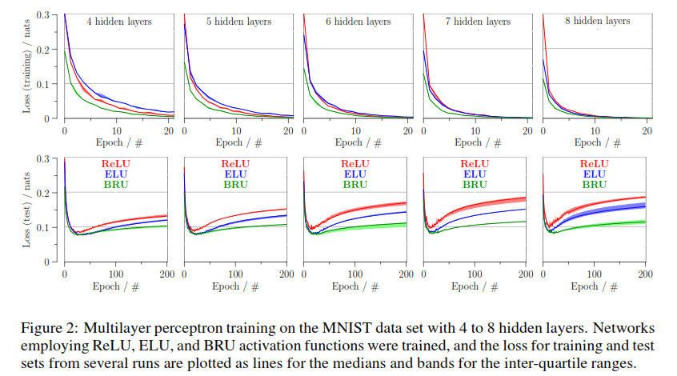
BRU

Slide 22
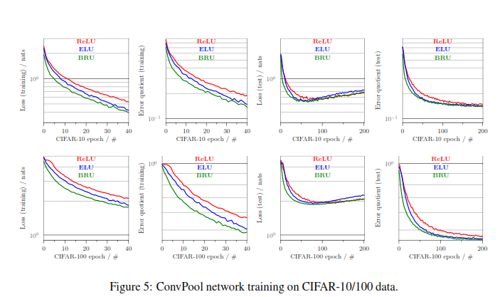
Speed

Slide 23
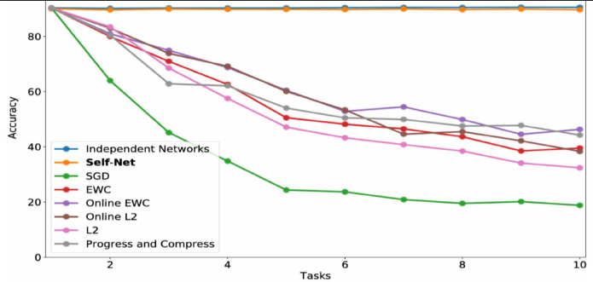
Self Net

Slide 24
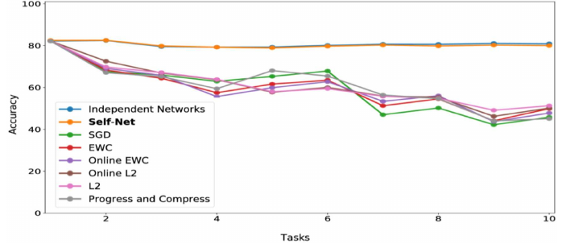

Slide 25
